Slide 1

Data Preprocessing and Feature Engineering
Agenda
Handling Missing Data
Feature Selection
Transformation
Imbalanced Data

Slide 2
Introduction to Data Preprocessing
Definition: Preparing raw data for machine learning models.
Data
Cleaning
Data Transformation
Data Integration
Data
Reduction
Removing errors, missing values, and inconsistencies.
Converting data into a suitable format.
Combining data from multiple sources.
Simplifying data while retaining important information.

Slide 3
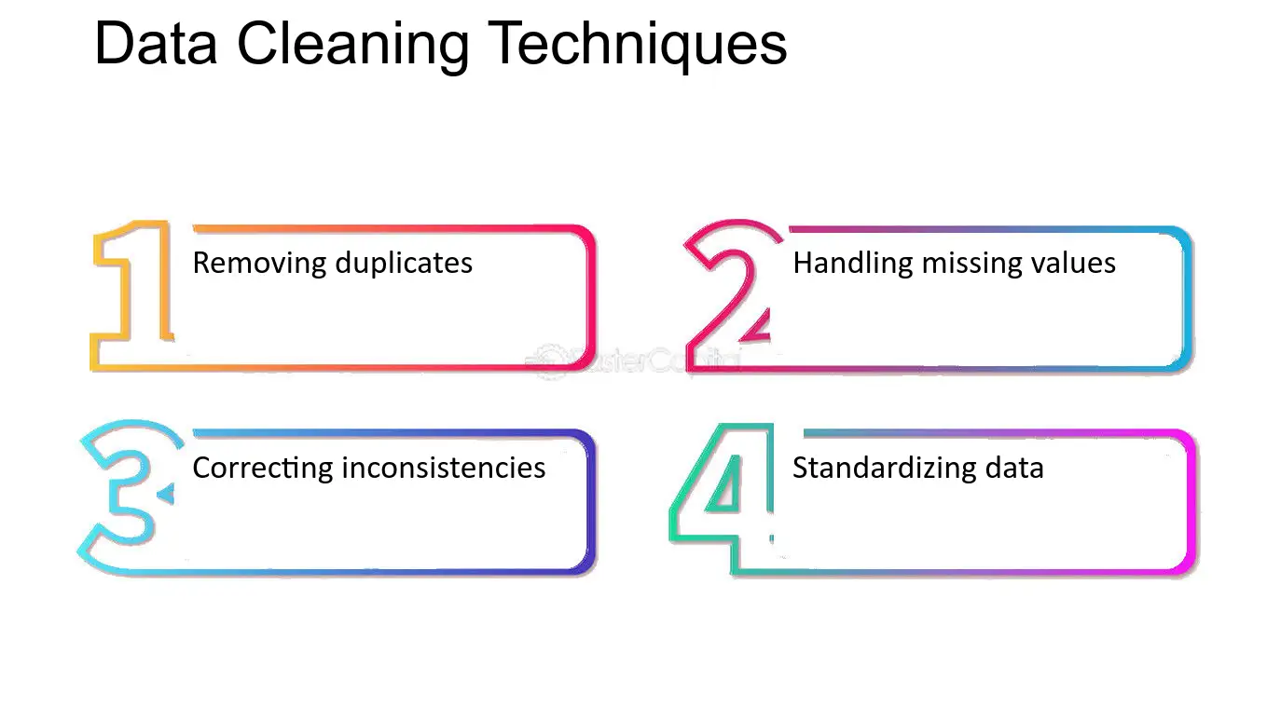
Data Cleaning
What is Data Cleaning?
Process of detecting and correcting errors in the dataset
Steps: Handling missing values, dealing with outliers, removing duplicates

Slide 4
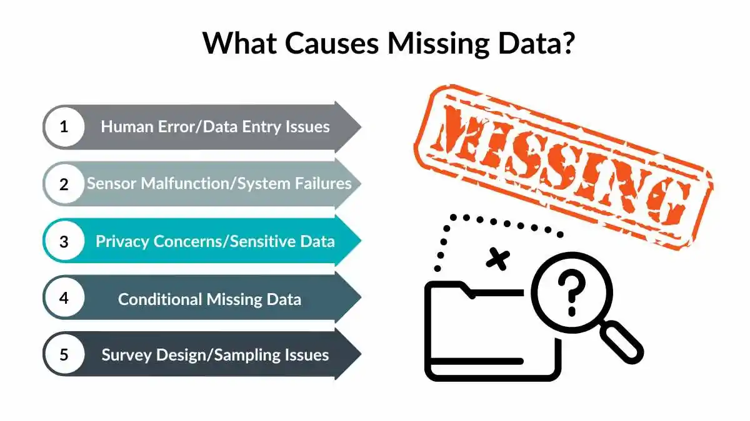
Handling Missing Values
Why missing values occur? (Human error, sensor failure, etc.)

Slide 5
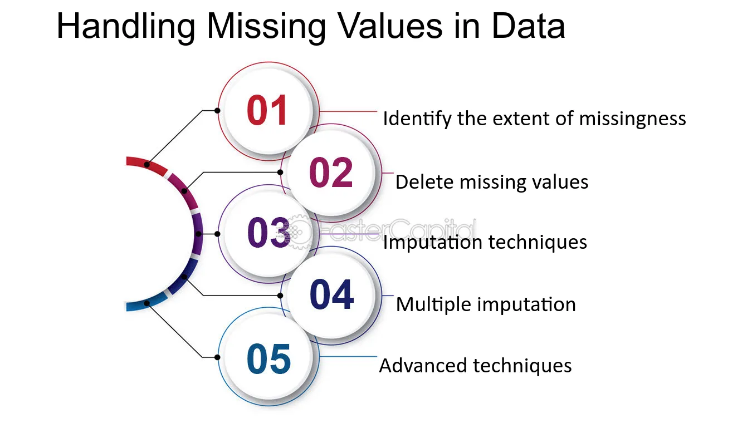
Handling Missing Values
Techniques to handle missing data:
Removing missing values
Mean/median/mode imputation
Predictive imputation (KNN, regression-based imputation)

Slide 6
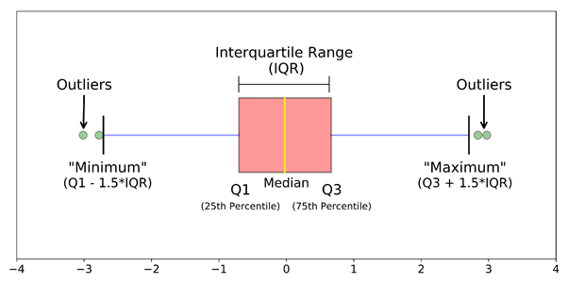
Handling Outliers
Definition: Data points that significantly differ from others

Slide 7
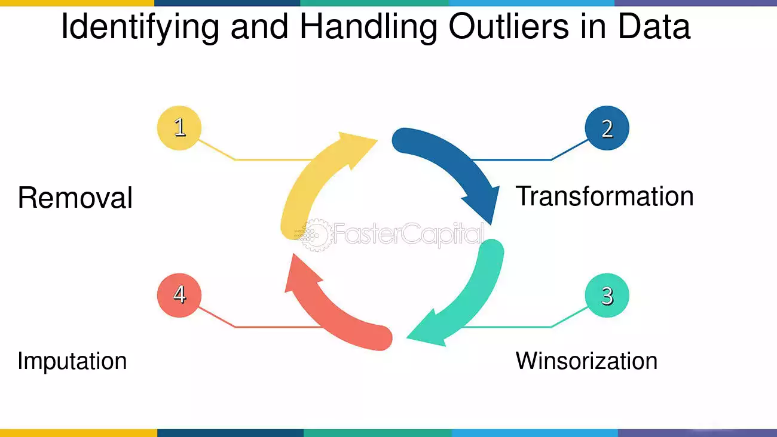
Handling Outliers
Techniques to handle outliers:
Z-score method: Detects outliers using standard deviations.
IQR method: Identifies outliers using quartiles and interquartile range.
Winsorization: Limits extreme values to reduce impact.
Removing based on business logic: Eliminates unrealistic or irrelevant data points.

Slide 8
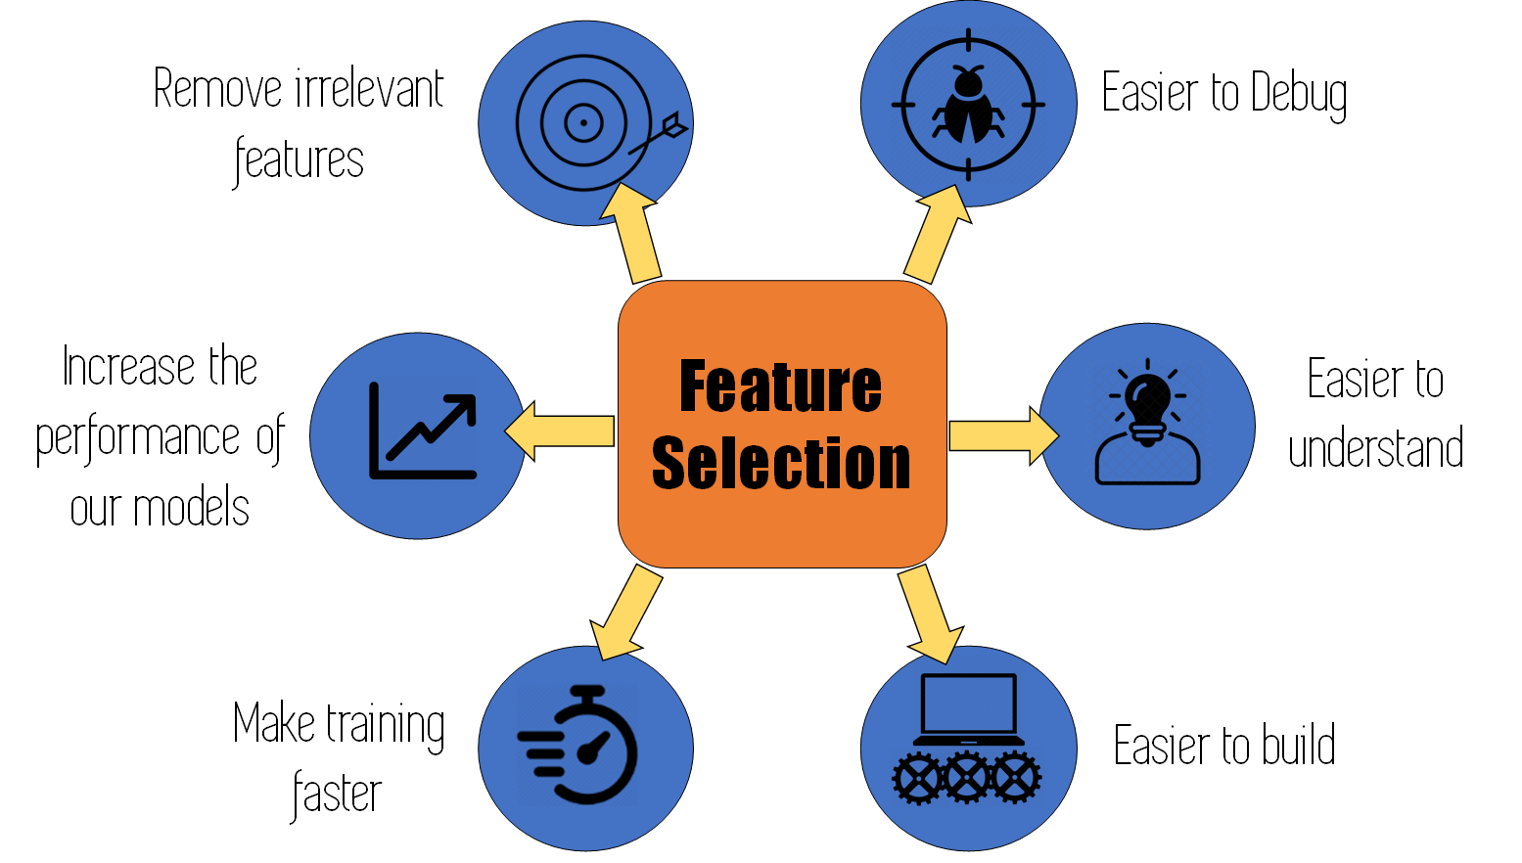
Feature Selection
What is Feature Selection?
Selecting important features to improve model efficiency
Benefits:
Reduces overfitting
Speeds up computation
Enhances model interpretability

Slide 9
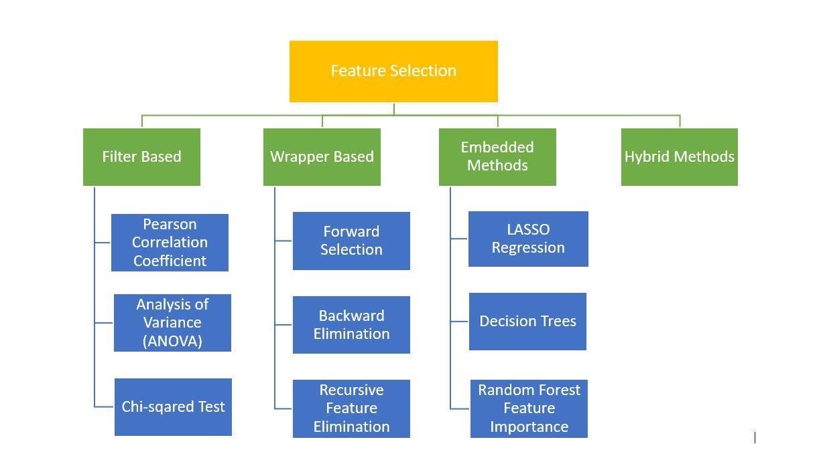
Feature Selection Methods

Slide 10
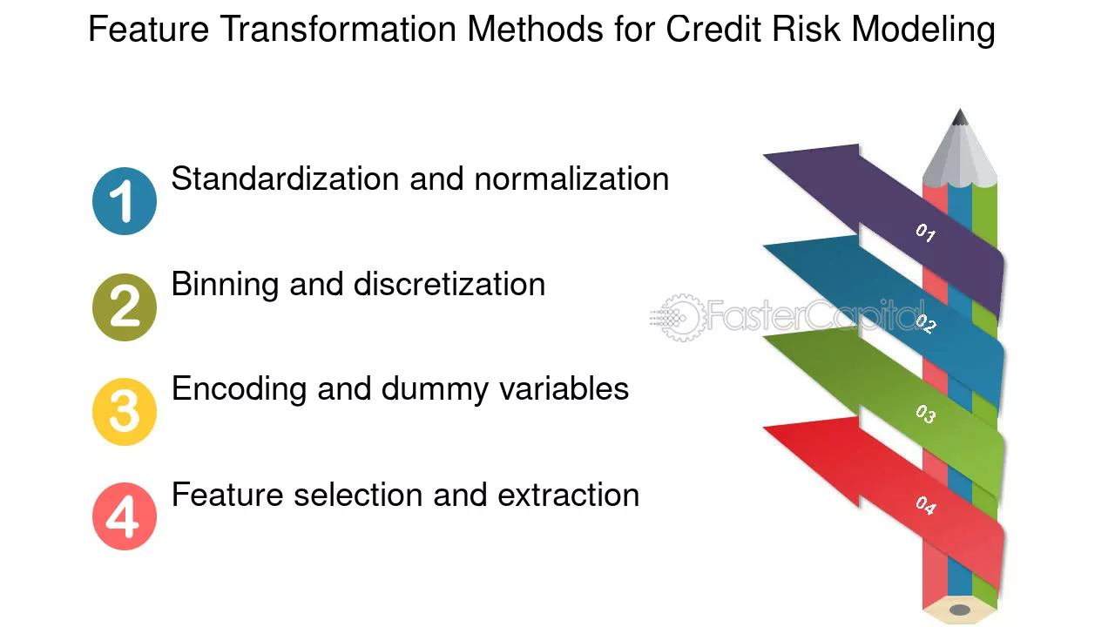
Feature Transformation
What is Feature Transformation?
Modifying data to improve model performance

Slide 11
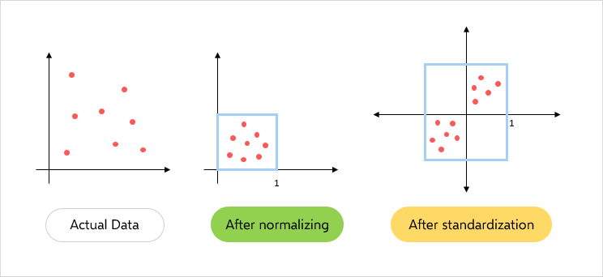
Scaling & Normalization
Scaling (Standardization): Mean = 0, Standard Deviation = 1 (e.g., StandardScaler)
Normalization (Min-Max Scaling): Rescales data to [0,1] (e.g., MinMaxScaler)

Slide 12
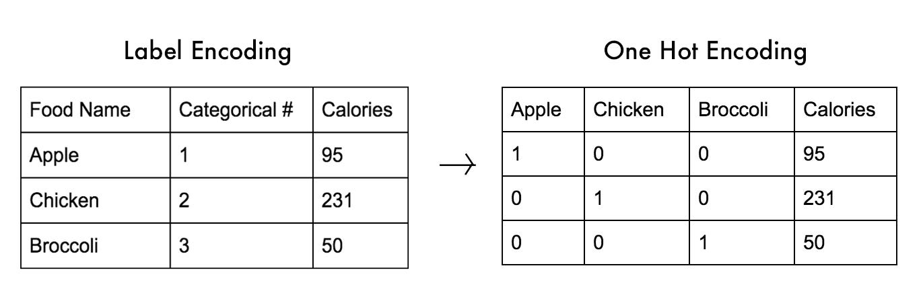
Encoding Categorical Variables
Why encoding is needed? (ML models need numerical input)
Methods: Label Encoding , One-Hot Encoding

Slide 13
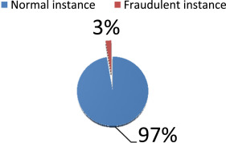
Handling Imbalanced Data
What is Imbalanced Data?
When one class has significantly more samples than another
Example: Fraud detection (97% normal, 3% fraud cases)

Slide 14
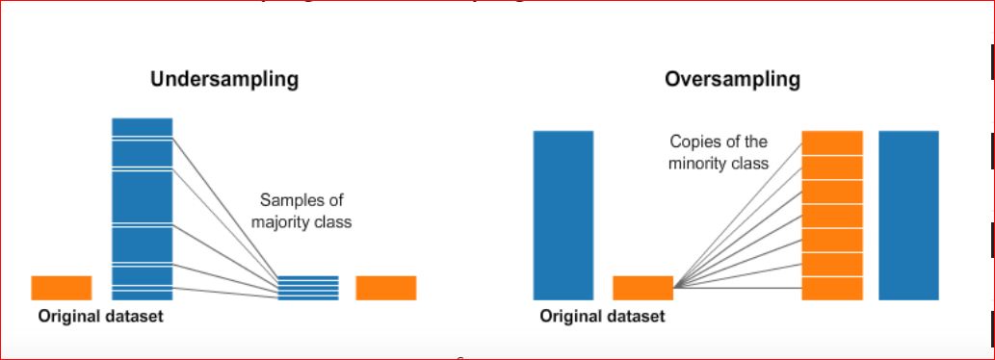
Techniques to Handle Imbalanced Data
Resampling Methods
Oversampling (SMOTE, ADASYN)
Undersampling (Random, Tomek Links)

Slide 15
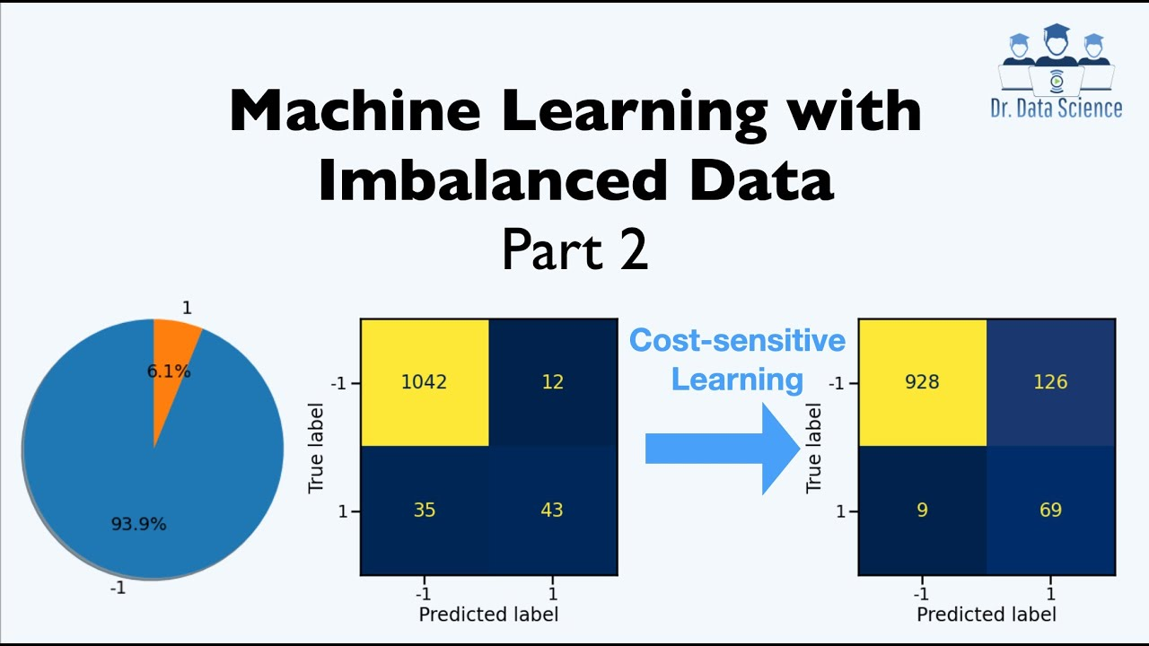
Techniques to Handle Imbalanced Data
Cost-Sensitive Learning
Assigning higher weights to minority class

Slide 16
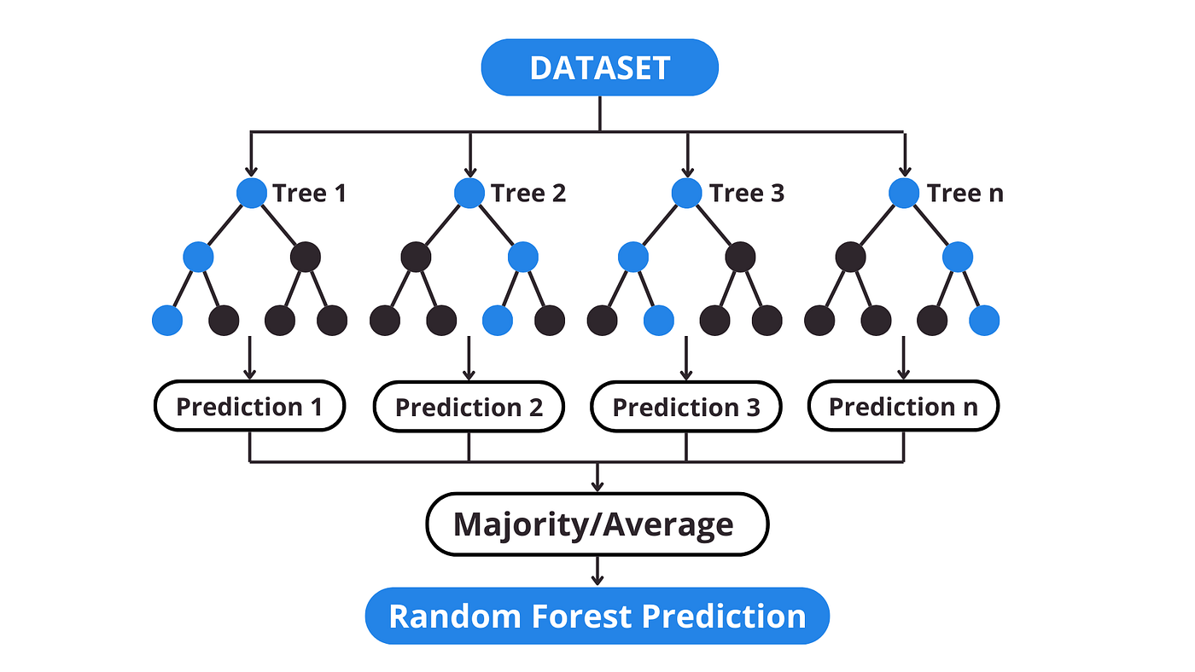
Techniques to Handle Imbalanced Data
Algorithmic Approaches
Tree-based models (Random Forest, XGBoost handle imbalance well)

Slide 17
Thank You

